Slide 1
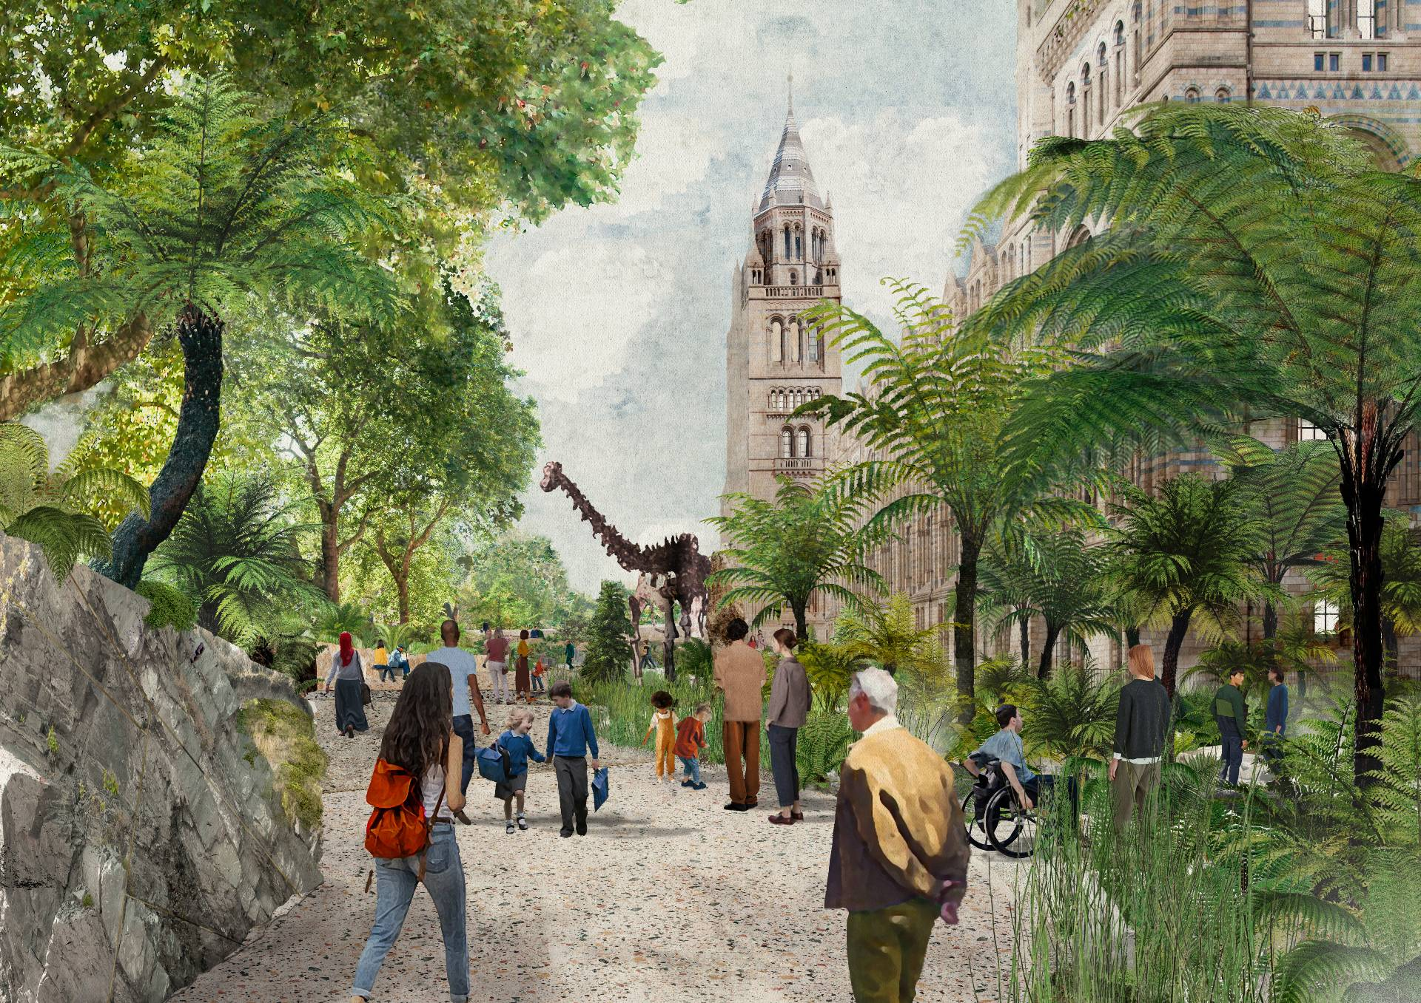

Data infrastructures for biological acoustics
Ed Baker
Natural History Museum, London
🦗.fm
Notes:
Good afternoon and thank you for joining us for this session in which we’ll introduce some of the ways that we’re developing and employing digital technologies to monitor and support recovery of the UK’s urban nature

Slide 2
Can we just play together nicely….
Ed Baker
Natural History Museum, London
🦗.fm
Notes:
Good afternoon and thank you for joining us for this session in which we’ll introduce some of the ways that we’re developing and employing digital technologies to monitor and support recovery of the UK’s urban nature

Slide 3
Why museums?

Slide 4
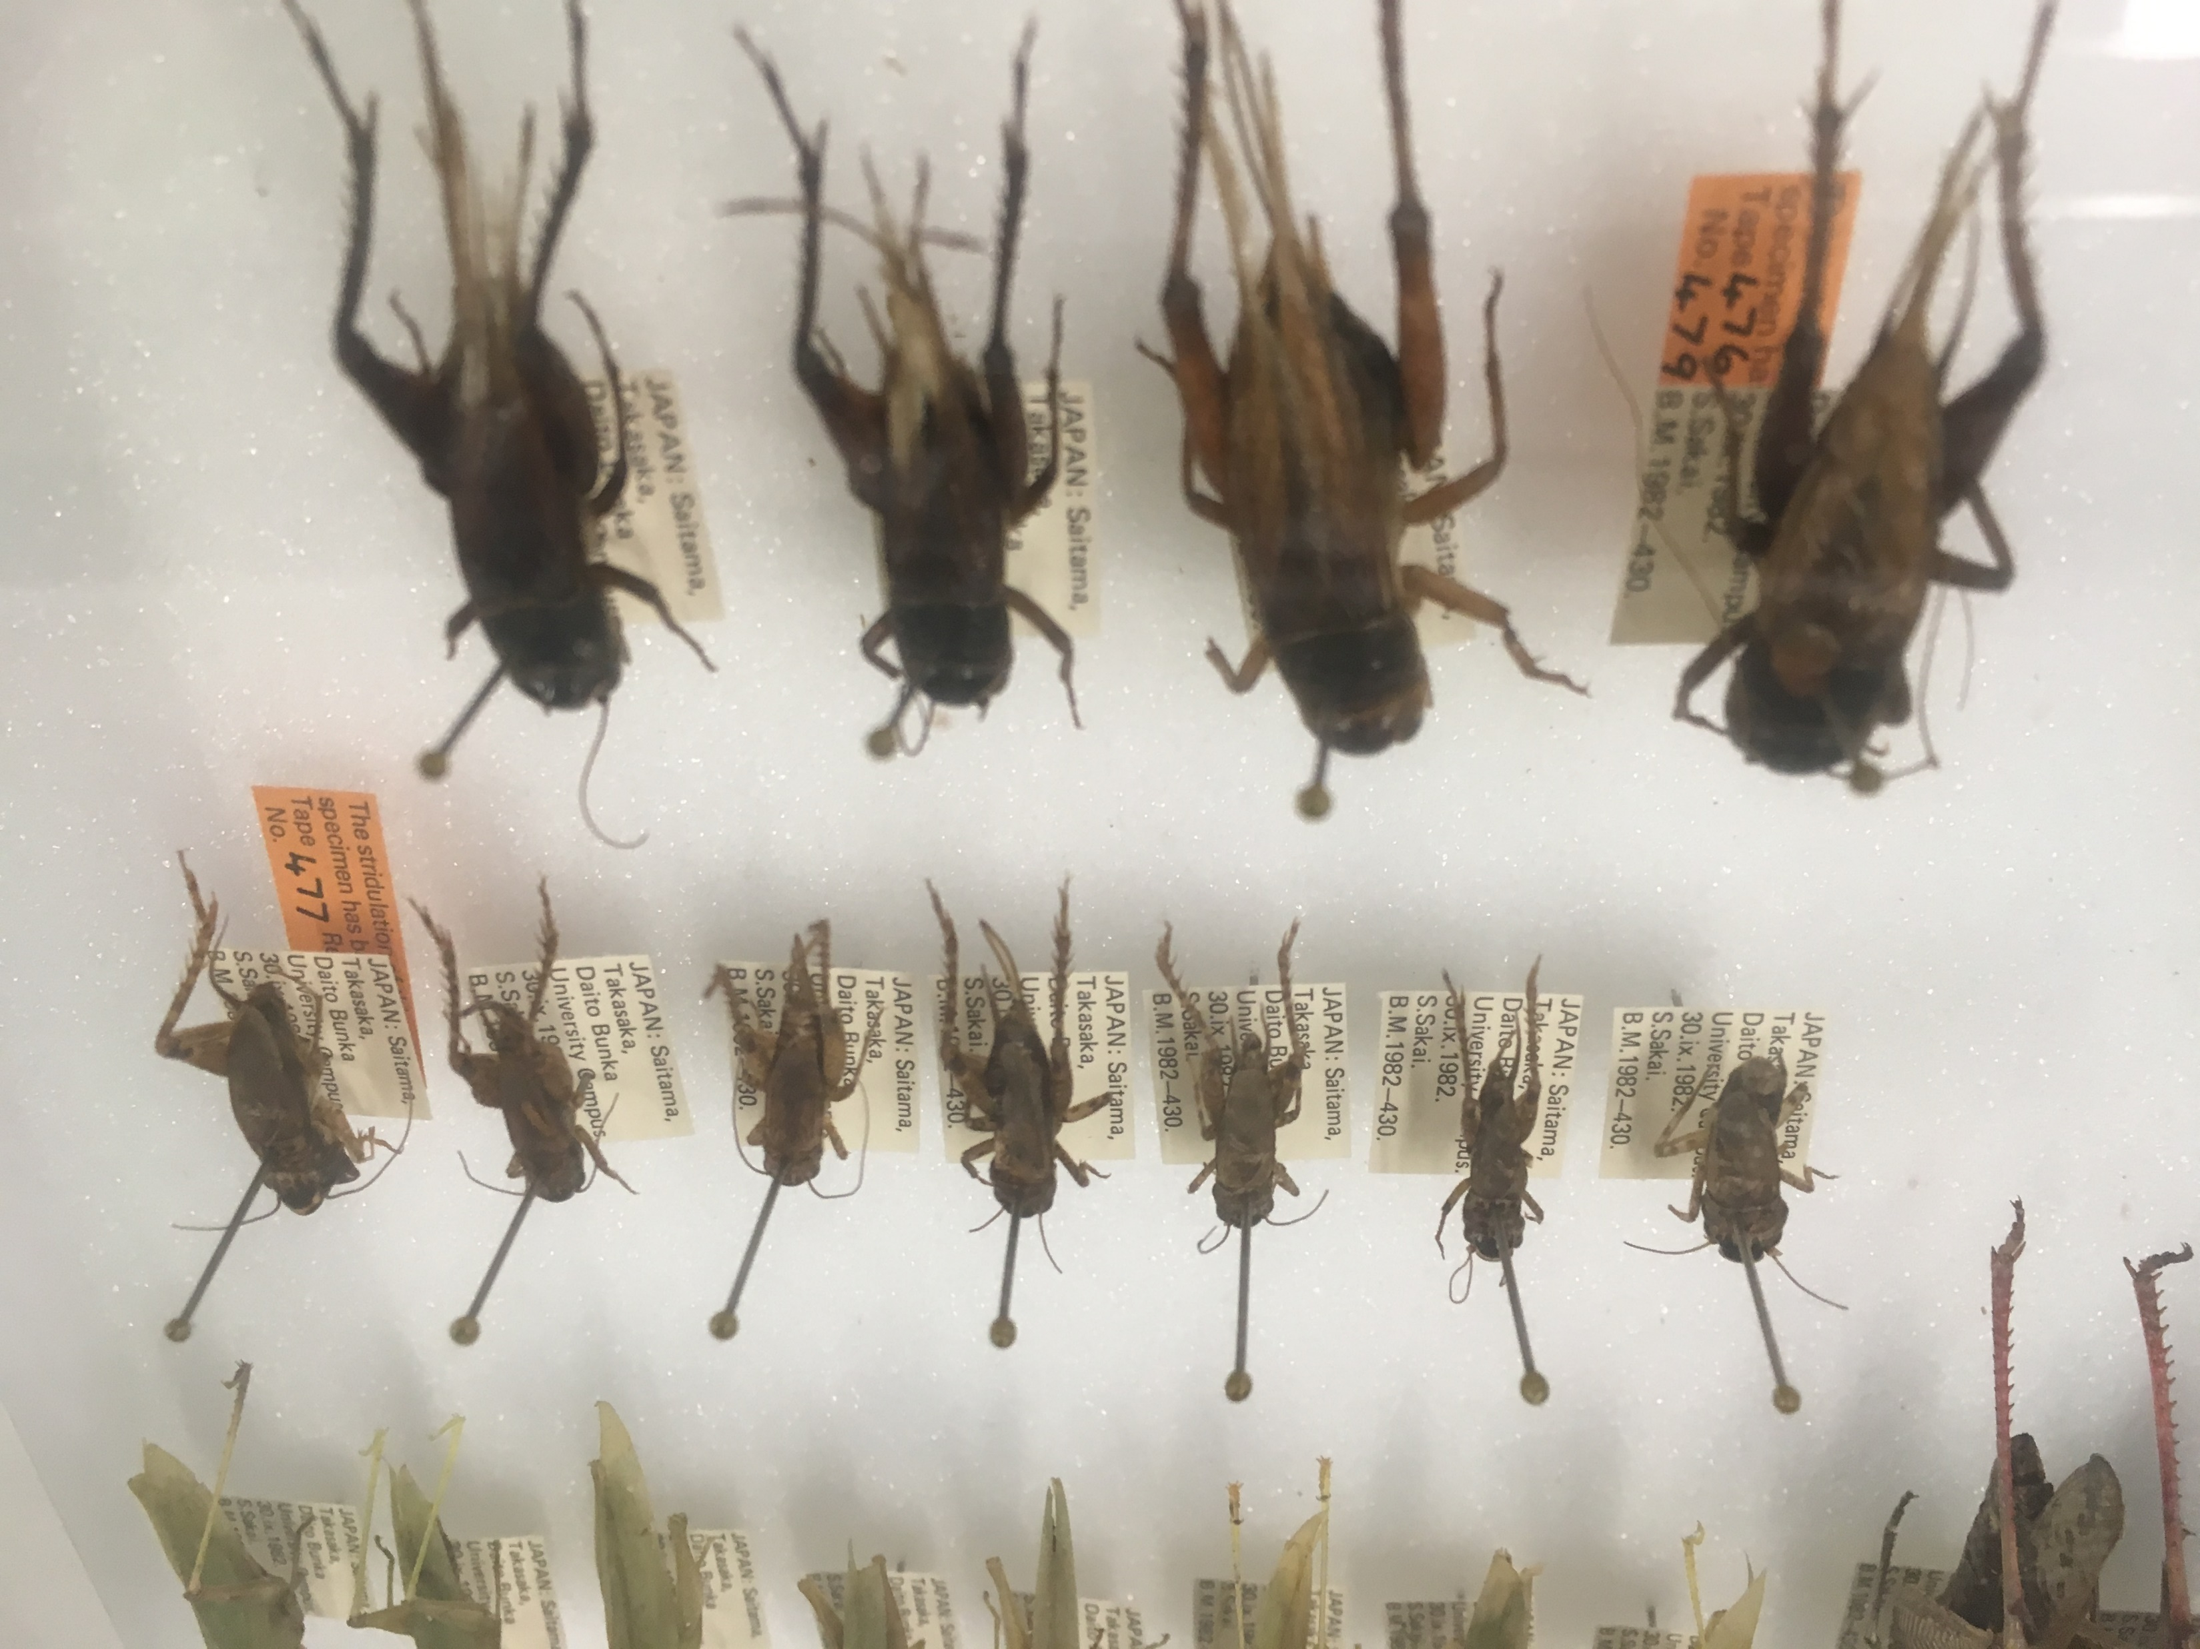

Slide 5
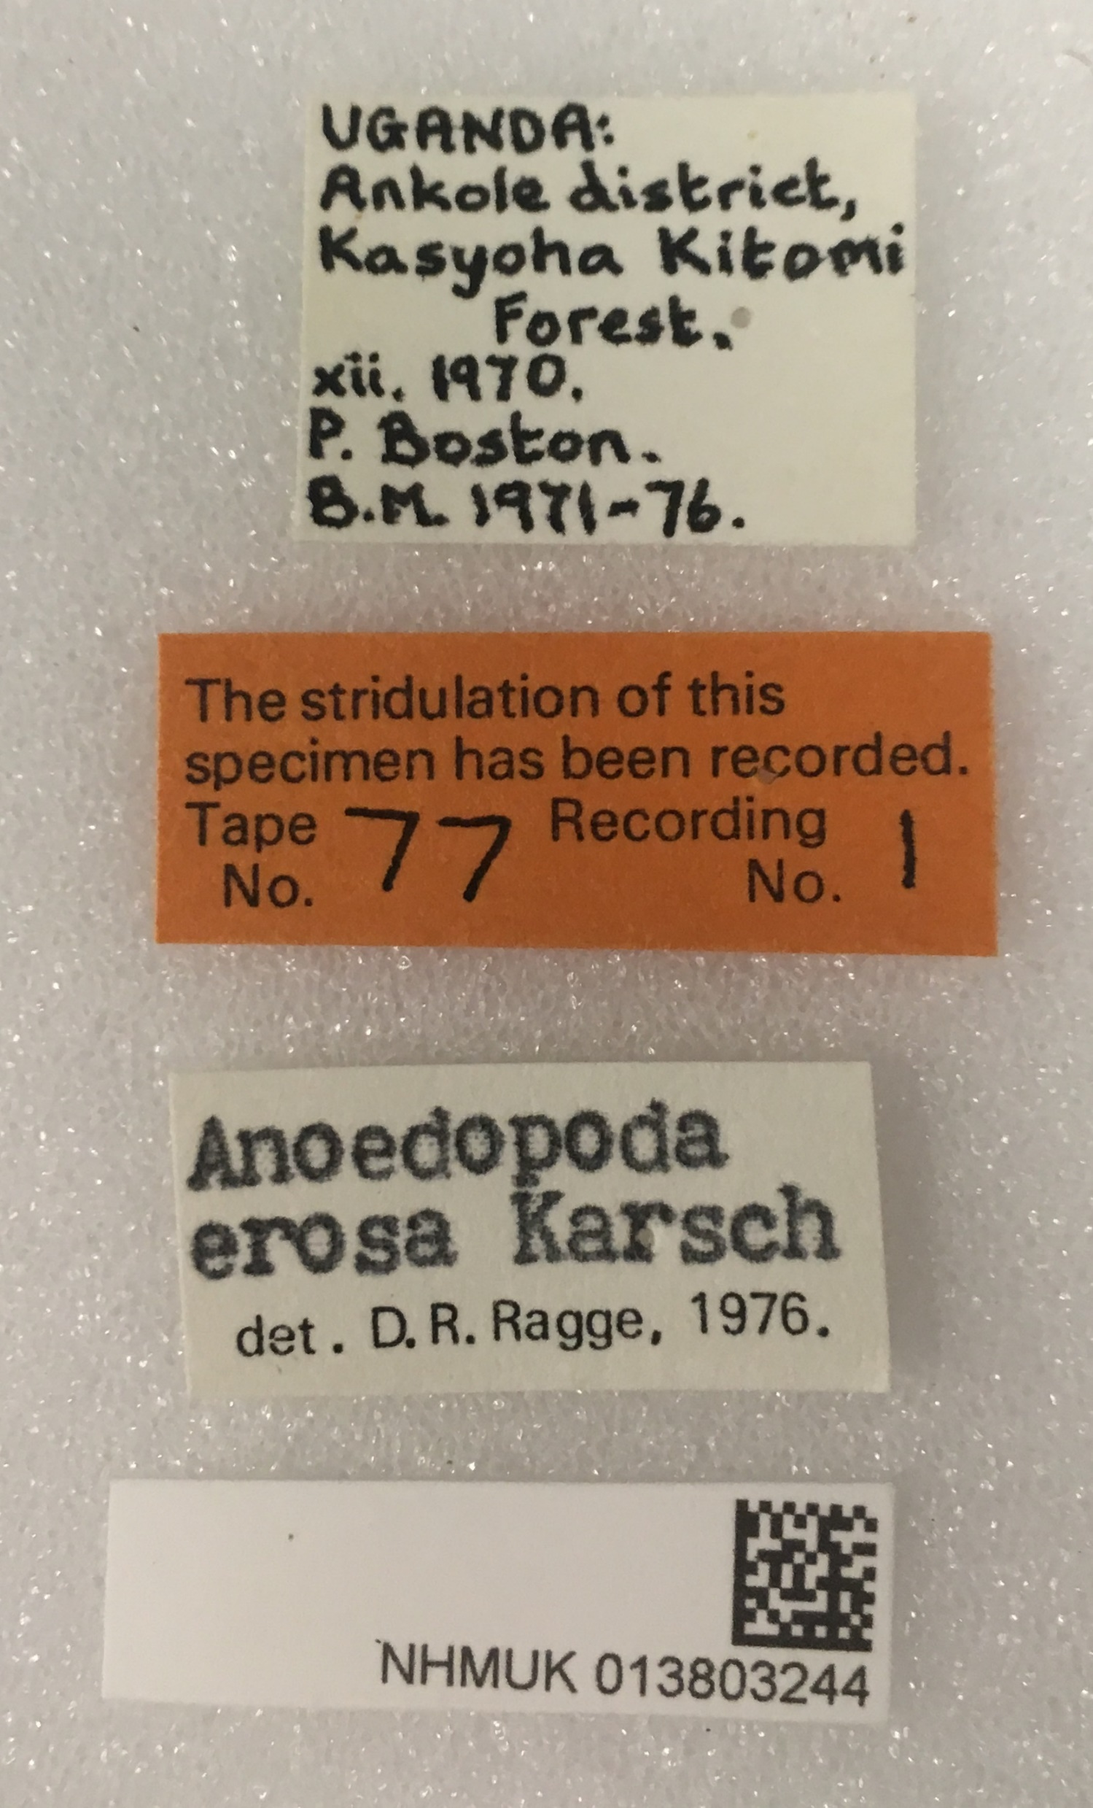

Slide 6
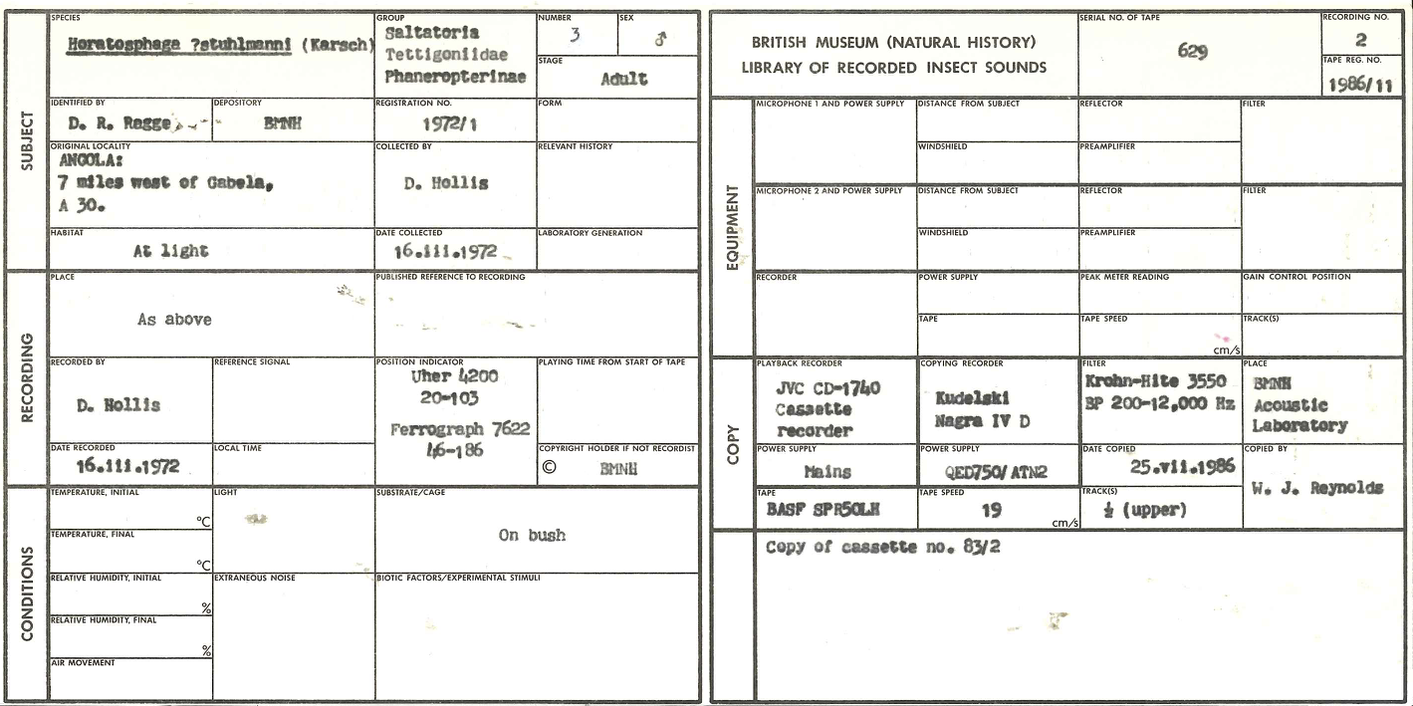

Slide 7
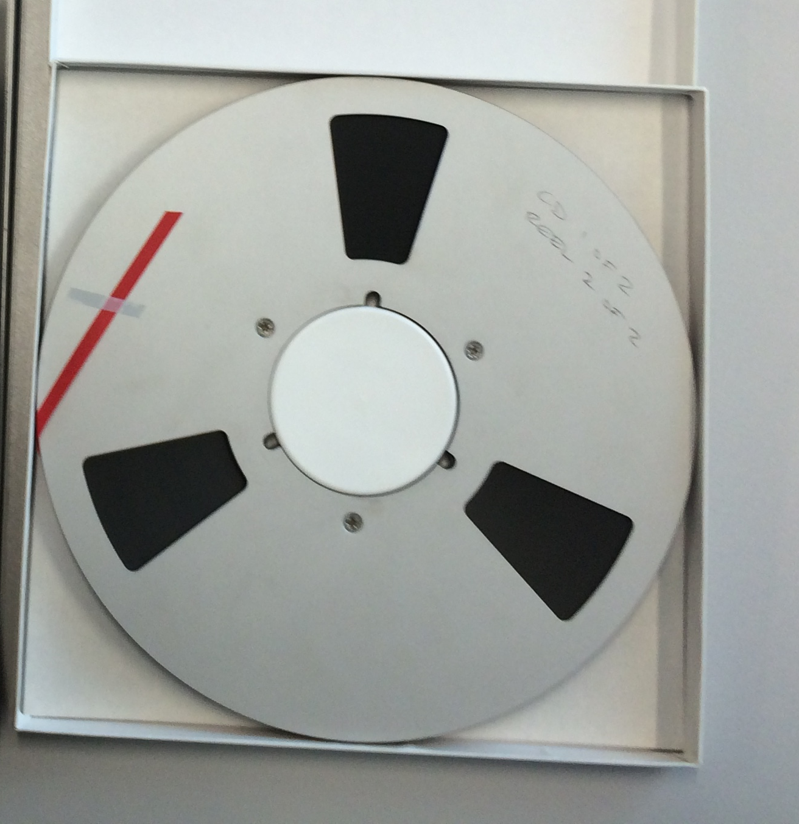

Slide 8
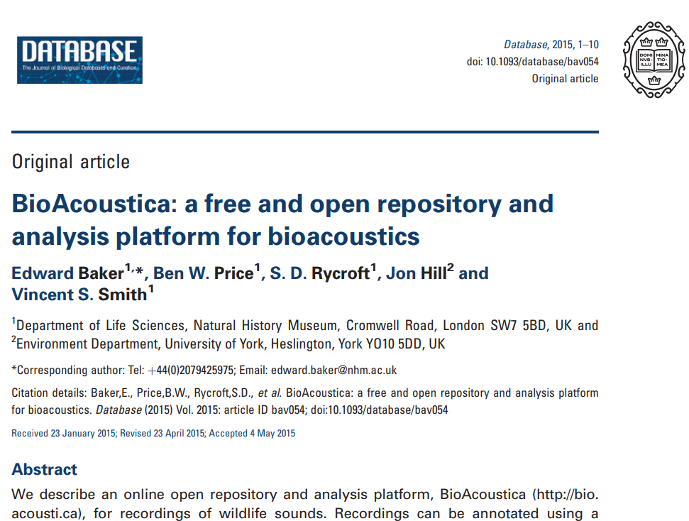

Slide 9
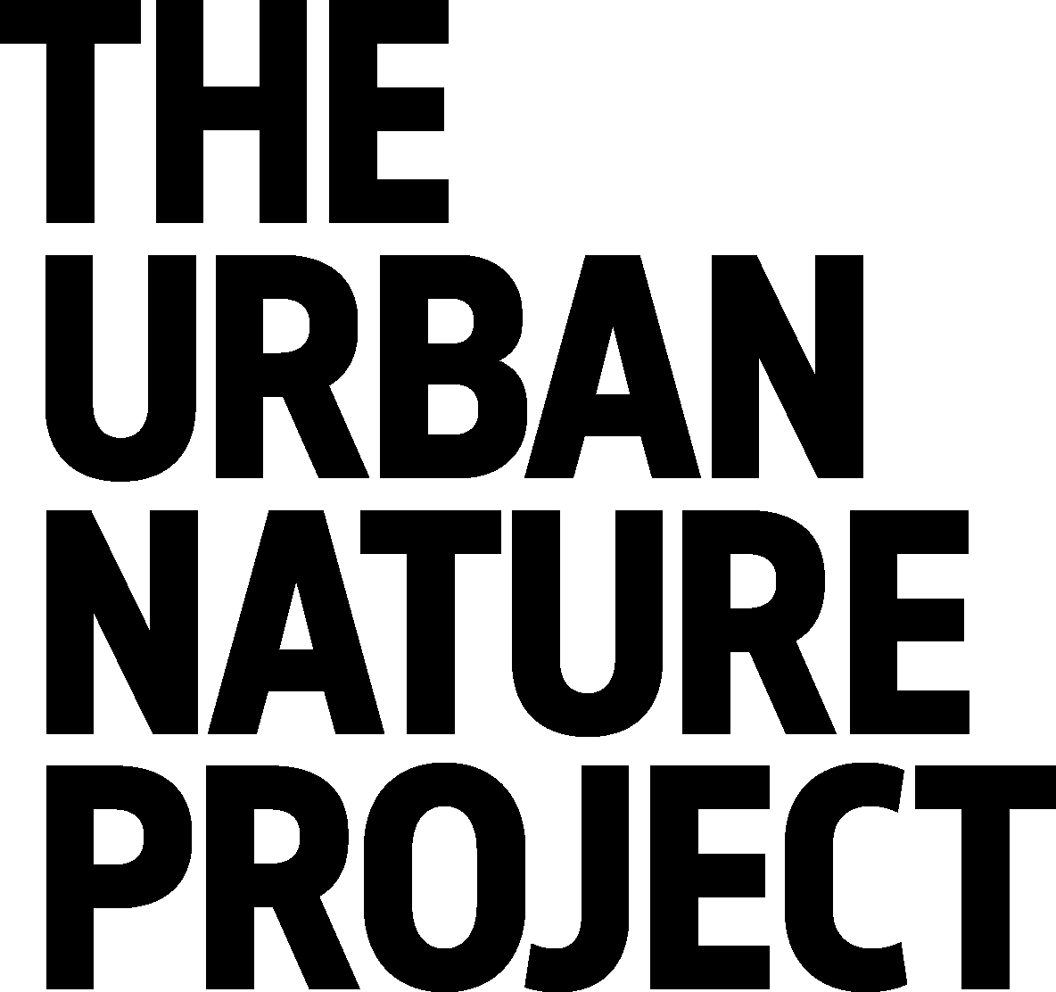


Notes:
And today we wanted to introduce one of our most ambitious programmes that aims to inspire a connection with nature and progress UK nature recovery
It’s called the Urban Nature Project and is a programme that is led by the NHM in collaboration with a UK-wide partnership of cultural organisations and conservation charities. To underpin the science outputs of the project we are creating a Data Ecosystem powered by AWS technology

Slide 10
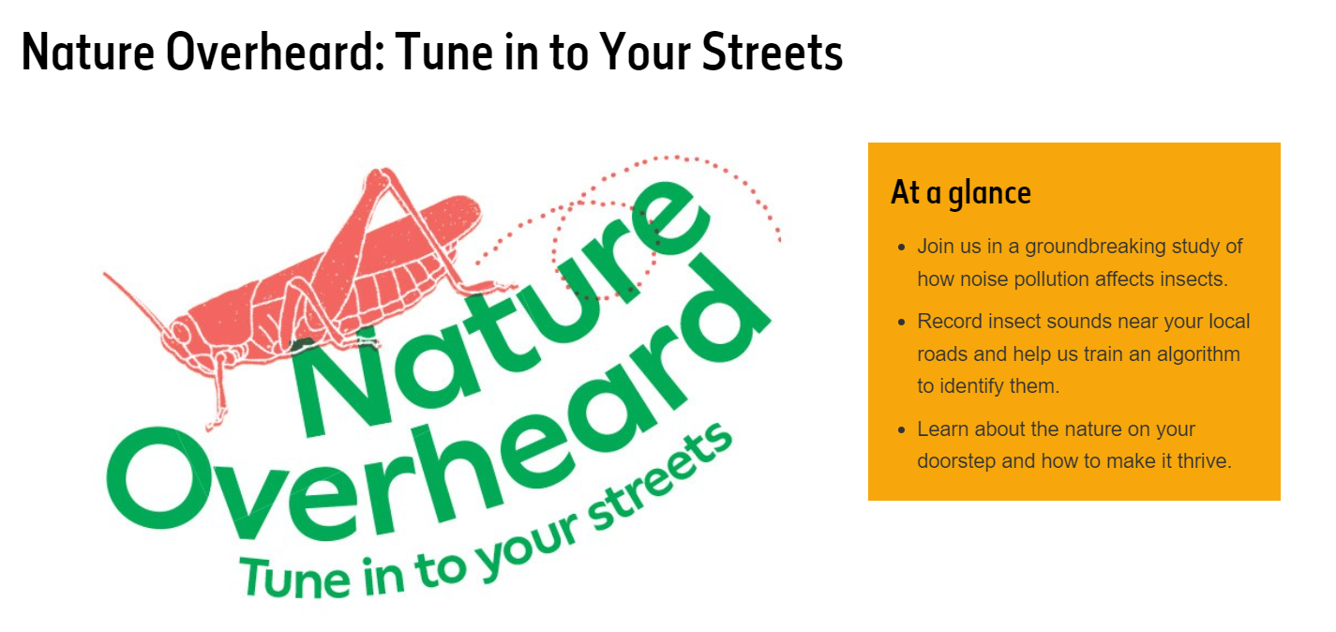
Notes:
Another example of how we’re building on our on-site research is community or participative science
Here where we’re actively using digital tech to connect people with their local urban nature and engage audiences in scientific research using a familiar device – their mobile phone.
Open to all, but aims to empower young people by focusing on their interests, curiosity and concerns – co-designed with school pupils “How can we make roads better for nature?”
Human-made noise can cause behavioural and physiological changes in animals
First study to look at impact of road noise on insects - at scale - in the UK
56,000 participants in activities in 2023

Slide 11
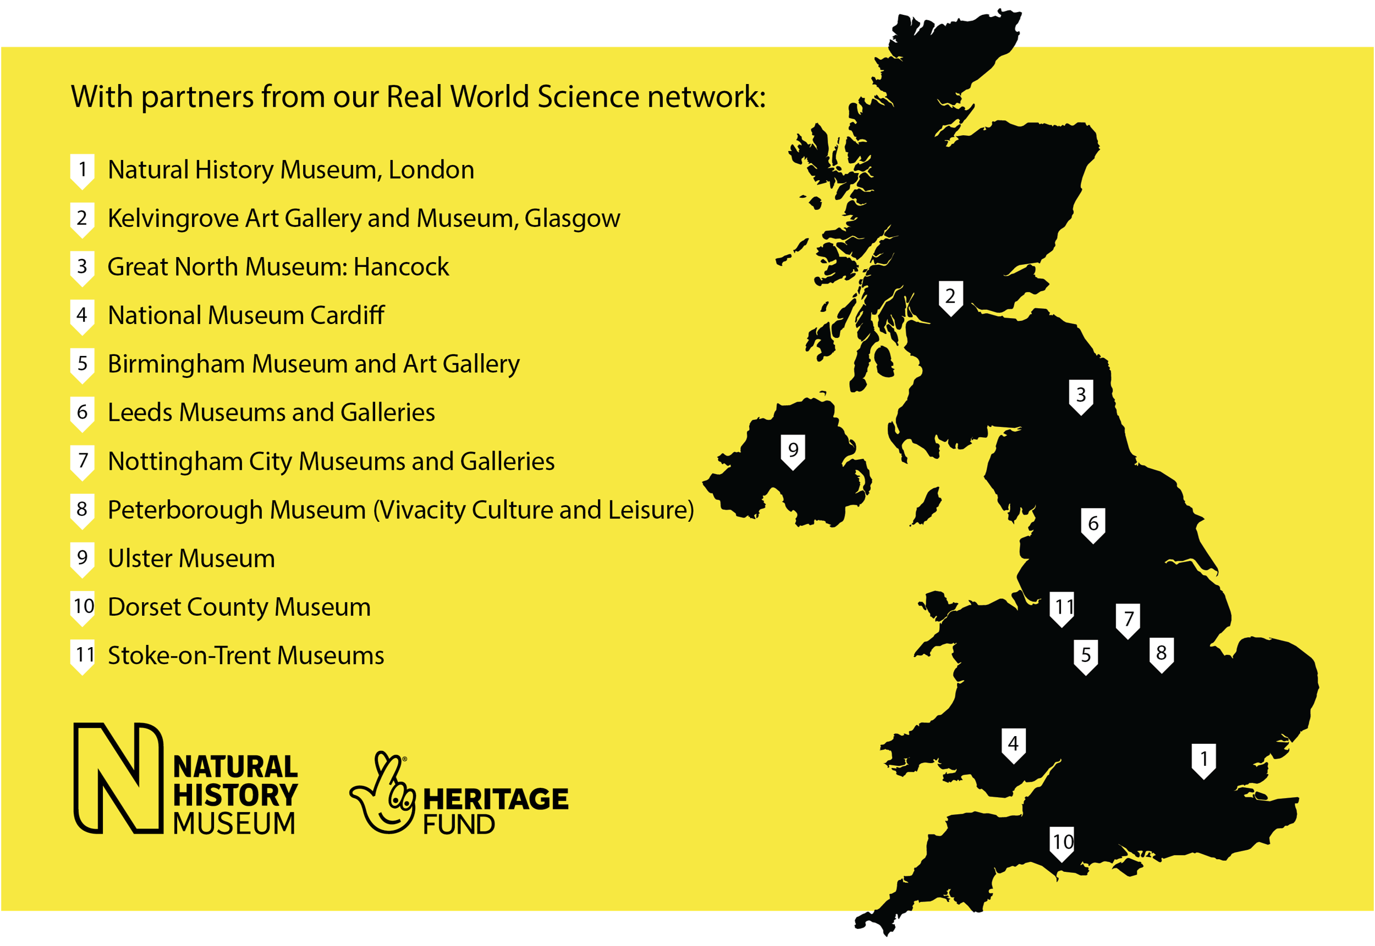
Urban Nature Project
Partner Network

Slide 12

Urban Nature Project
Partner Network

Slide 13
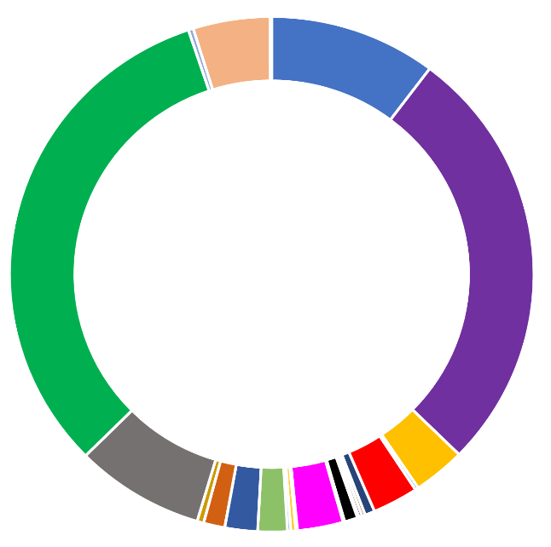
Urban Nature Project
Partner Network

Slide 14
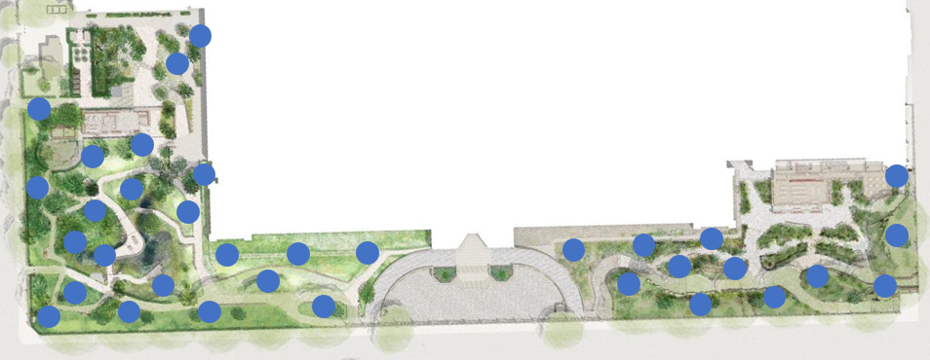
Acoustic sensor network
Permanent, integrated digital infrastructure
Acoustics
Air
Water
Soil
Timber
Ultrasound
Spatial (Becky Heath – another room)
Notes:
Talk through sensor network and how it can be used by others, plus how it is a model that can be extended at other locations

Slide 15
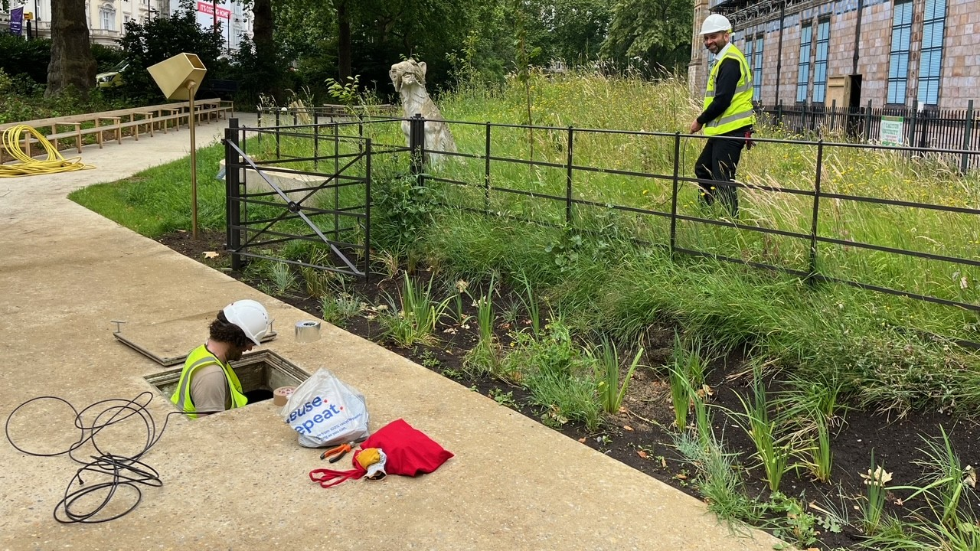

Slide 16
Some big questions
How will we preserve the data we collect? Bioacoustic vs Ecoacoustic
Where do we do analysis? Move analysis (rather than data or people)
Move to integrated infrastructures? Data/Analysis/Analyses (do each analysis once)

Slide 17
Some big questions
How will we preserve the data we collect? Bioacoustic vs Ecoacoustic
Where do we do analysis? Move analysis (rather than data or people)
Move to integrated infrastructures? Data/Analysis/Analyses (do each analysis once)
Search

Slide 18
Why museums?
Collections / Research / Access
Treat recordings as voucher specimens (= digital as first-class object)
Learn from and leverage existing solutions

Slide 19
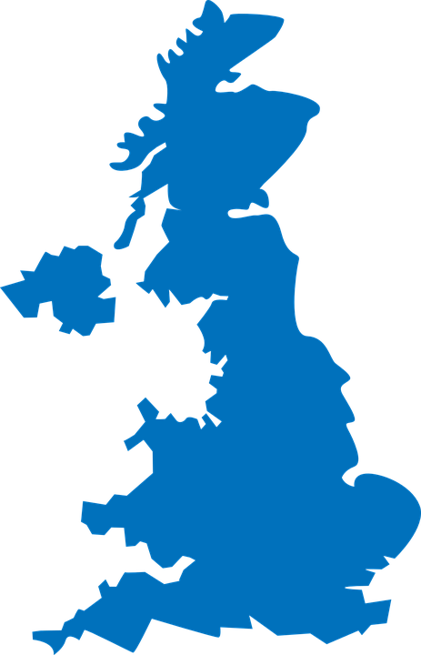

Integration inspiration

Slide 20


Integration inspiration

Slide 21
Integration inspiration
DarwinCore metadata standard

Slide 22
Integration inspiration
DarwinCore metadata standard
?
?
?

Slide 23
Integration inspiration
DarwinCore metadata standard
?
?
AudiovisualCore

Slide 24
Integration inspiration
DarwinCore metadata standard
AWS Data
Ecosystem
?
AudiovisualCore

Slide 25
TDWG AudiovisualCore
Metadata standard
Links to DarwinCore (widely used)
Media (digital, also physical)
Recent audio/video expansion
Regions of interest

Slide 26
TDWG AudiovisualCore
Maintenance Group
Ed Baker - Natural History Museum, London (Convener)
Steve Baskauf - Vanderbilt University Jean & Alexander Heard Library
Douglas Boyer - Duke University & MorphoSource
Niels Klazenga - Royal Botanic Gardens Victoria
Rebecca Snyder - Smithsonian Institution, National Museum of Natural History
Dan Stowell - Tilburg University and Naturalis Biodiversity Centre
Kate Webbink - Field Museum of Natural History

Slide 27
TDWG AudiovisualCore
Maintenance Group
Ed Baker - Natural History Museum, London (Convener)
Steve Baskauf - Vanderbilt University Jean & Alexander Heard Library
Douglas Boyer - Duke University & MorphoSource
Niels Klazenga - Royal Botanic Gardens Victoria
Rebecca Snyder - Smithsonian Institution, National Museum of Natural History
Dan Stowell - Tilburg University and Naturalis Biodiversity Centre
Kate Webbink - Field Museum of Natural History

Slide 28

TDWG AudiovisualCore
github.com/tdwg/ac
2nd-6th September

Slide 29
TDWG AudiovisualCore
github.com/tdwg/ac

Slide 30
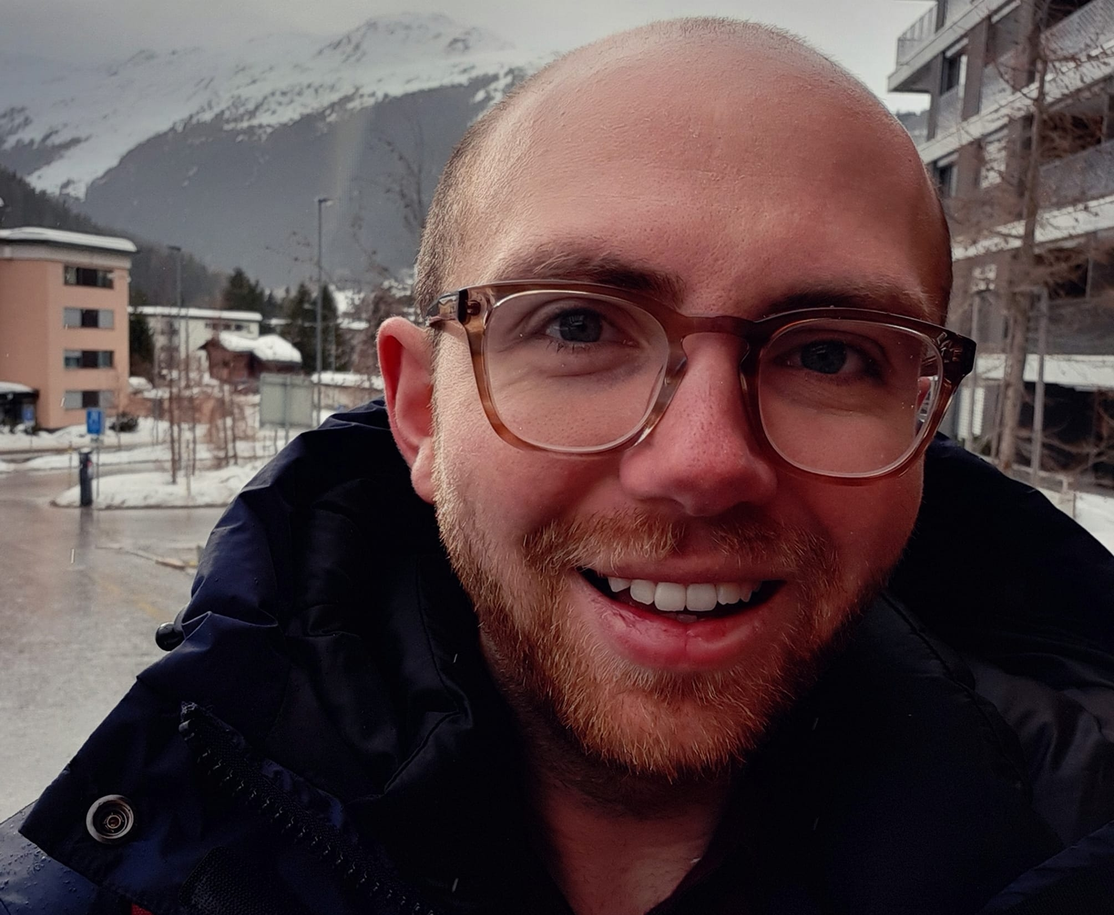
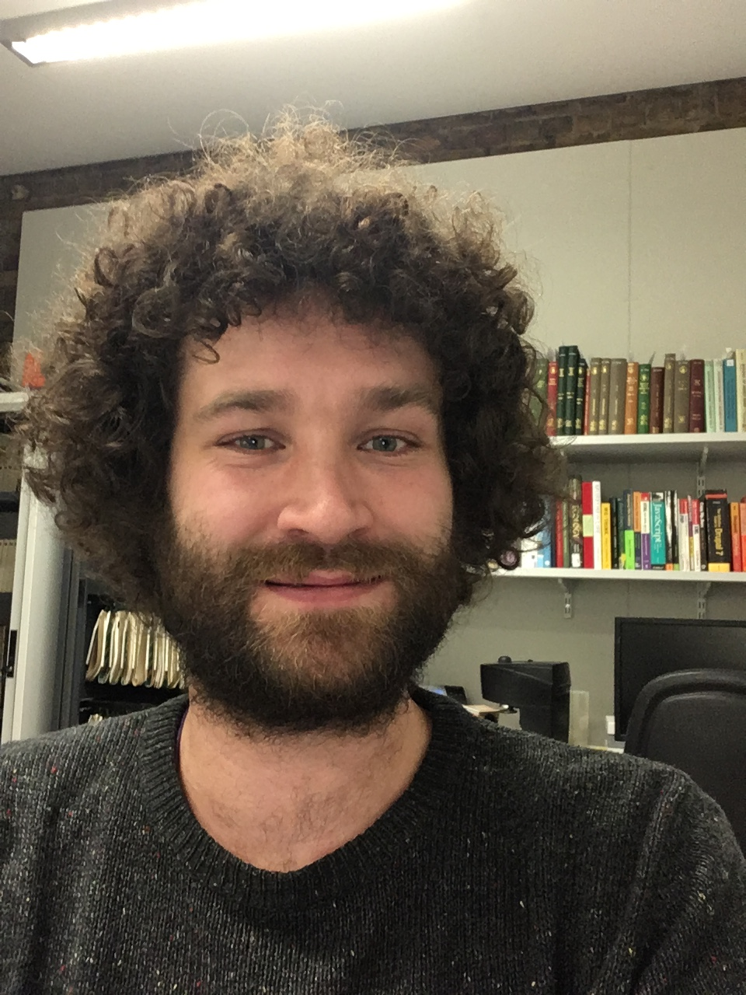
TDWG AudiovisualCore
github.com/tdwg/ac
2nd-6th September
Afterwards

Slide 31
Data Ecosystem

Slide 32
Prototype Aggregator
Recordings (NHM/Norway)
Annotations/ROI
Traits
audioblast.org

Slide 33
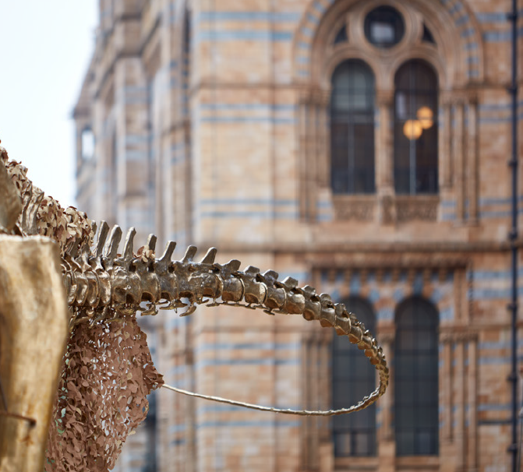
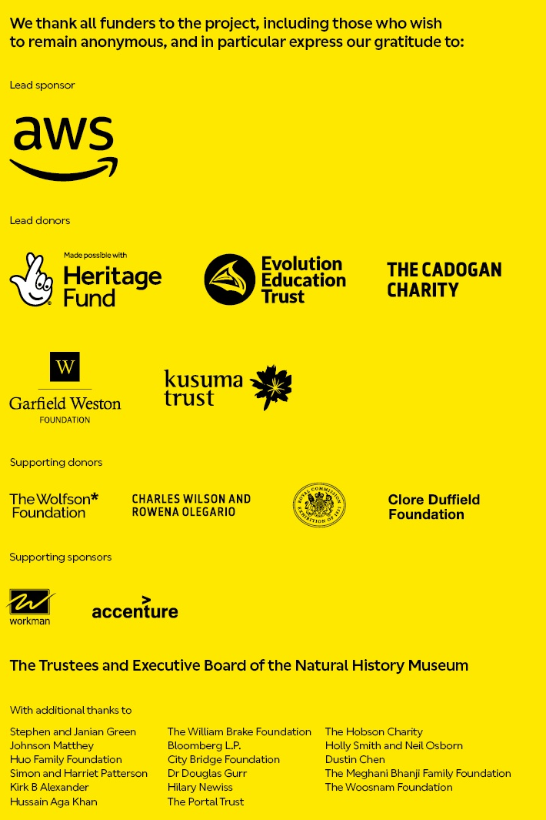
Museum gardens and Urban Research Station
18th July – www.nhm.ac.uk
Questions?
edward.baker@nhm.ac.uk
@edwbaker

